Slide 1
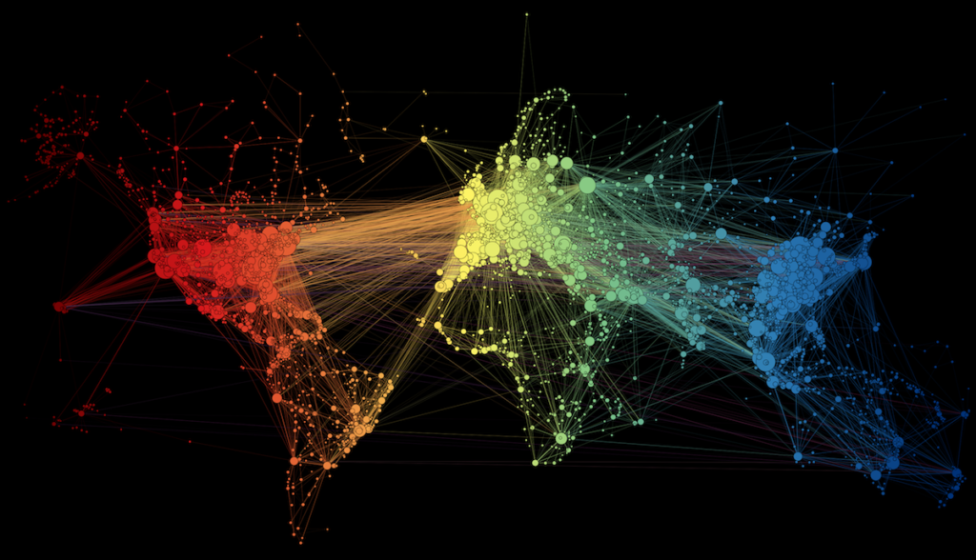
Network Analysis
Maryam Torkashvand
Spring 2024

Slide 2
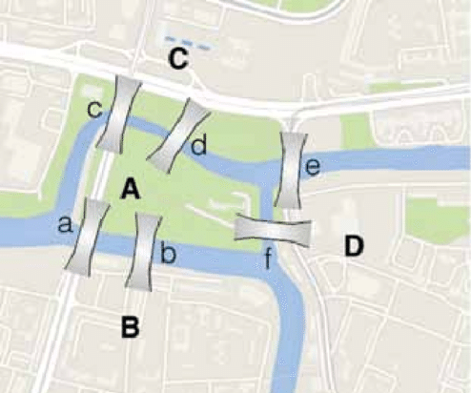
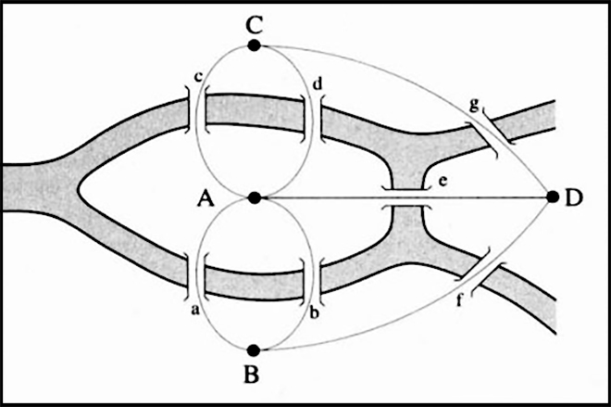
Seven Bridges of Königsberg
Can you cross all seven bridges exactly once without crossing any of them more than once?
Leonhard Euler solution

Slide 3
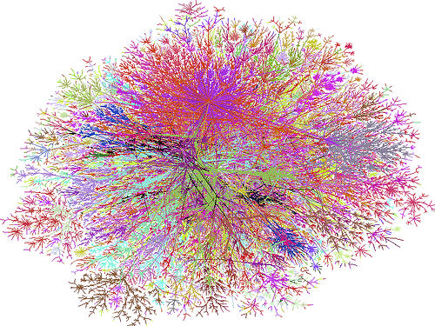
Now, networks are everywhere!

Slide 4
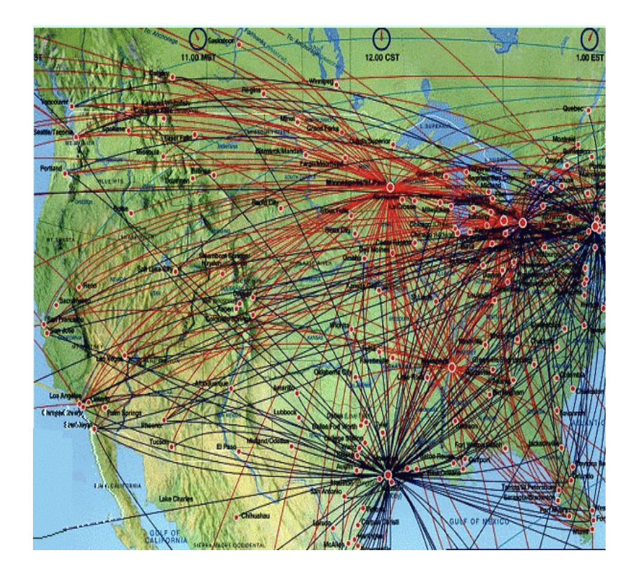
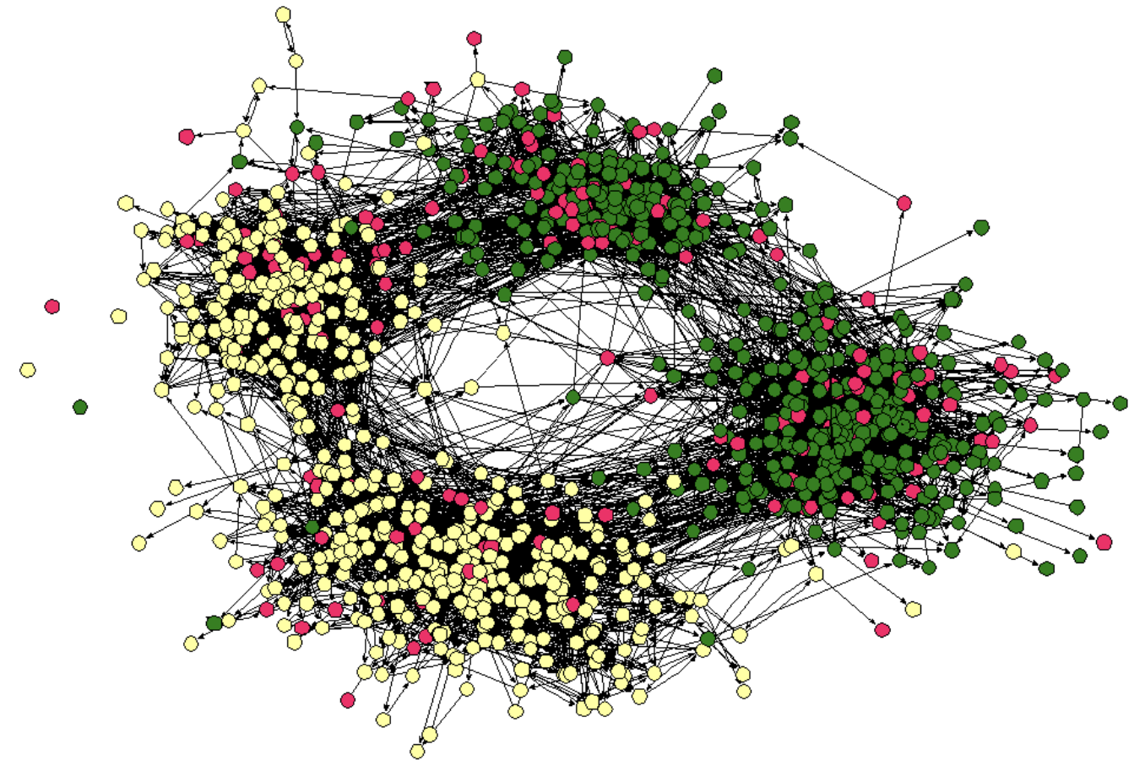
Now, networks are everywhere!
Friendship Network
Flight Network

Slide 5
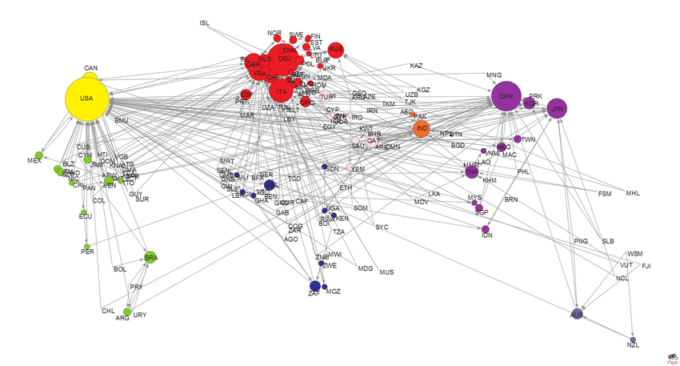
Now, networks are everywhere!
Trade Network

Slide 6
Terminology
Network = Graph
Nodes = Vertices, actor
Links = Edges, Relations
Clusters = Communities, Partitions, Regions

Slide 7
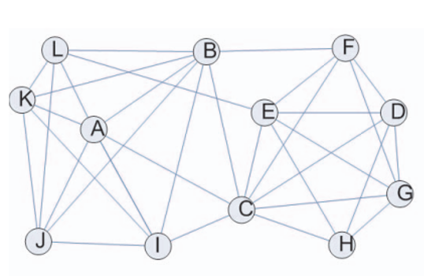
What is a Network
A Network is a collection of nodes interconnected by links.
Node
Link

Slide 8
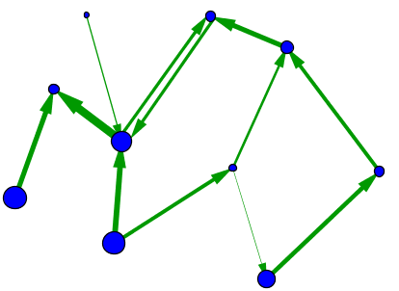
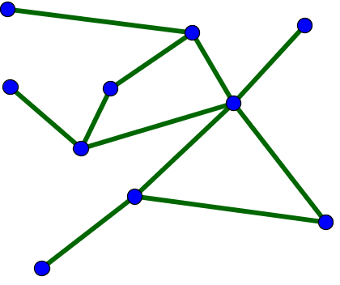
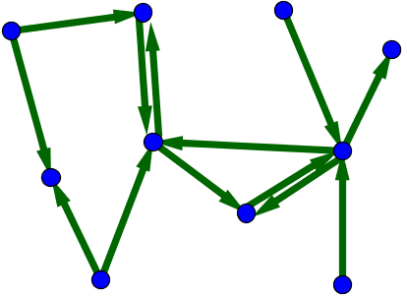
Type of Networks
A directed network where the edges and nodes have different weights, as indicated by their sizes.
An undirected network.
A directed network.

Slide 9
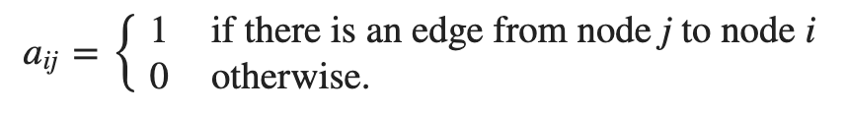
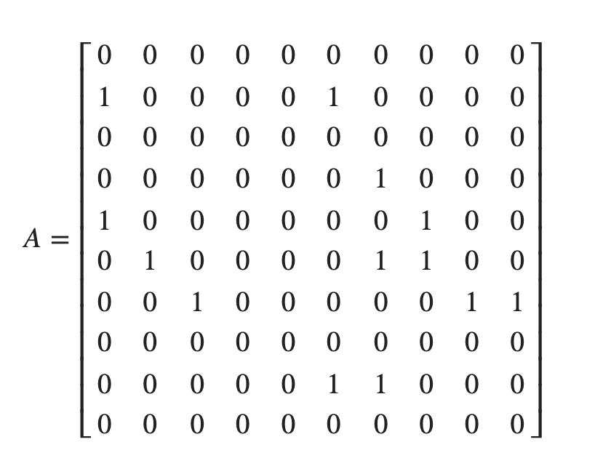
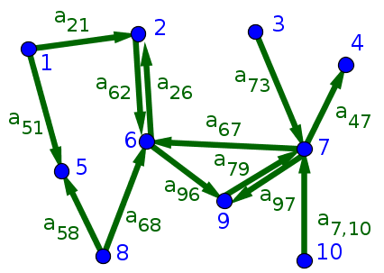
The adjacency matrix
For unweighted networks of N nodes without multiple connections, the network structure can be represented as an N×N adjacency matrix A.

Slide 10
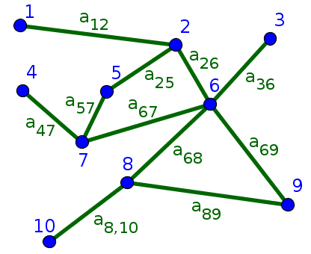
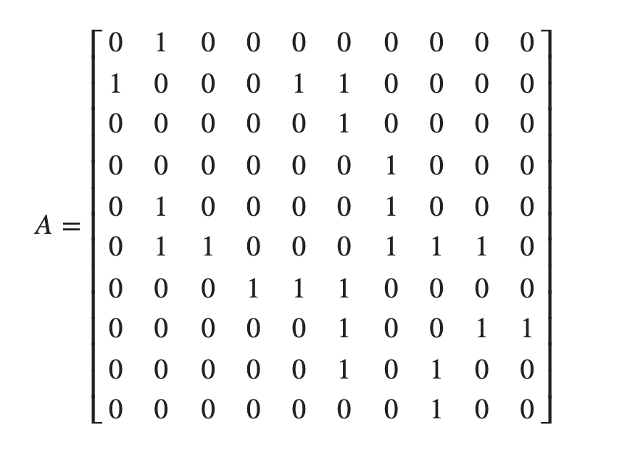
The adjacency matrix

Slide 11
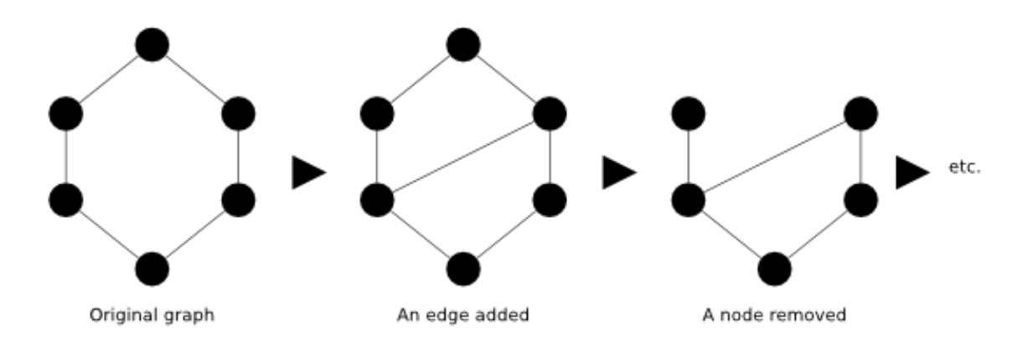
Temporal Networks

Slide 12
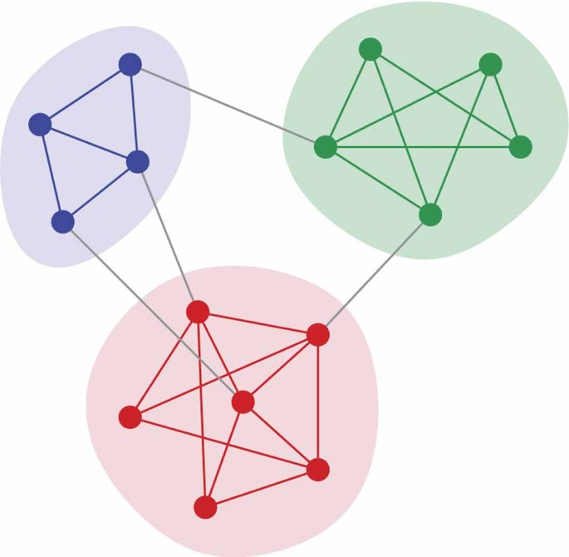
Network with communities
Sets of nodes with lots of internal connections and few external ones (to the rest of the network).
Figure reference: Newman (2012)

Slide 13
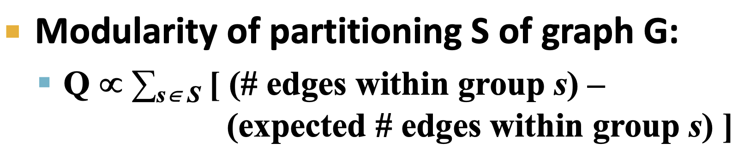
Modularity
A measure that quantifies the strength of division of a network into communities.

Slide 14
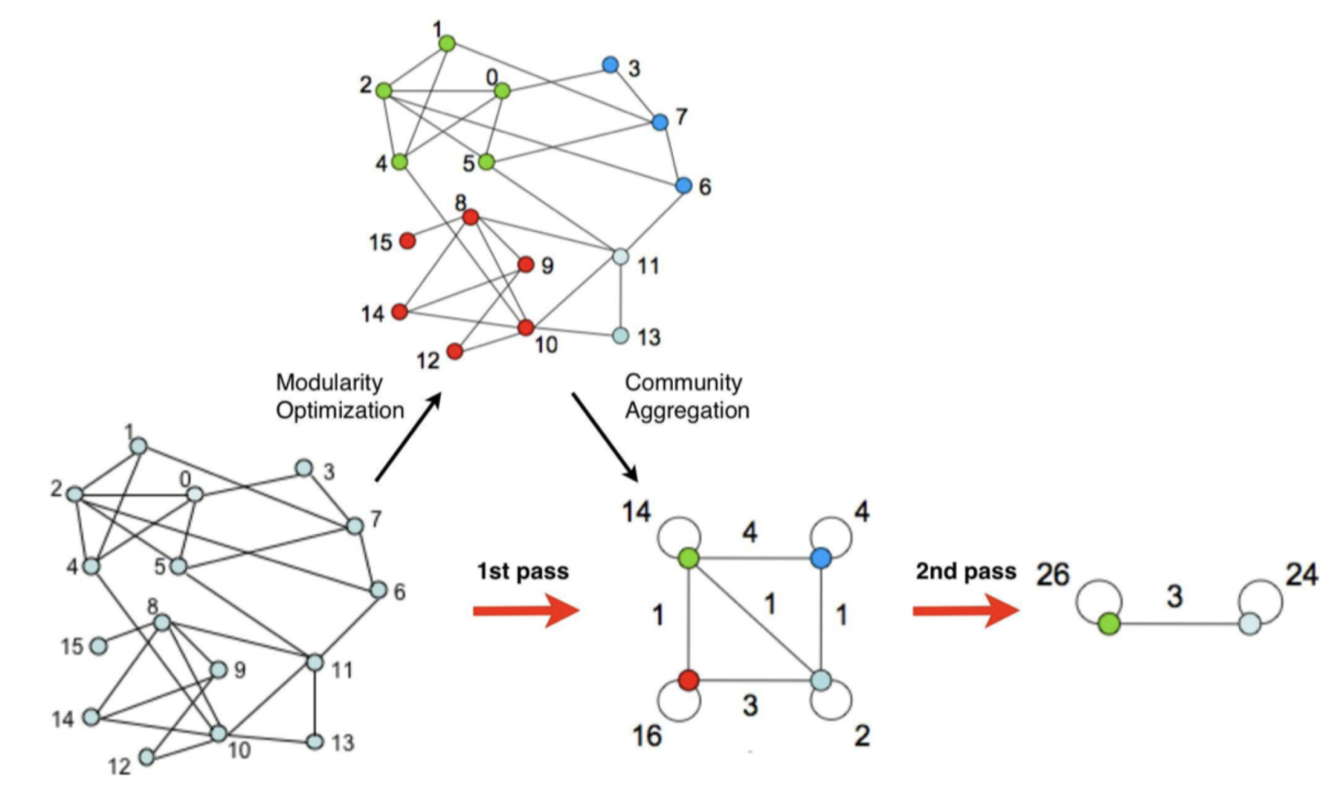
Louvain community detection Algorithm
Greedy algorithm for community detection
Supports weighted graphs
Widely utilized to study large networks

Slide 15
Tutorial
Creating the network of medical supplies trade within Africa
Extracting trade communities for medical supplies
Years: 2019, 2020, 2021
Data Source: UN Comtrade Dataset. https://comtradeplus.un.org/

Slide 16




Tutorial
The data and tutorial notebook can be accessed from:
ICON: Week 15, Network_Torkashvand

